Slide 1
Visualising Loneliness
A summary of predicted prevalence in loneliness at older age
Data Story telling by Nujcharee Haswell
University of York St John
Notes:
Hello, this is Visualising Loneliness, a story about the prevalence of loneliness at older age in england
Im nujcharee haswell and I am your data story teller.

Slide 2


Abstract
This story summaries the output of predictive model on prevalence of loneliness among adults aged 65 and over across England.
Based on the study conducted by Age UK, a charity working to promote health and well-being in elderly – the aim is to explore the presence of spatial neighbourhood pattern and whether being in a populated area associated with loneliness.

Slide 3
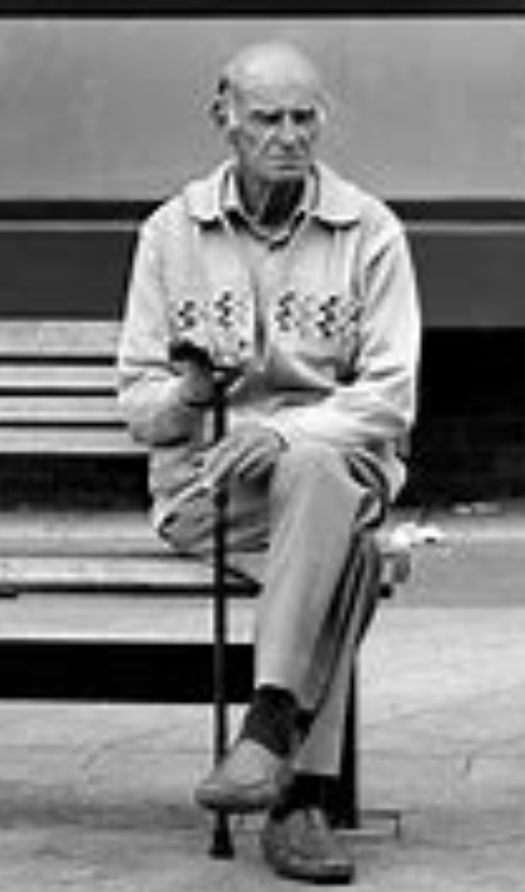
Introduction
Meet Frank: age 75
Loneliness is an experience when one feels the absence of the connection. It is seen as a subjective emotion yet has effects on one’s physical and emotional well-being
It is reported to be prevalence in elderly
Poorer health elderly are 6 times the odd of being lonely compared to those with excellent health
Loneliness is prevalent among widows, separated or divorced
Living alone does not cause one to be lonely
Does living in a populated area link with loneliness?
1
Frank lives alone in Co. Durham, North East of England. He has fair health *. His wife sadly passed away two years ago.
Notes:
Let us meet Frank – a gentleman aged 75 who lives alone. - his wife passed away recently he got fair health
He is one of many millions of people suffer with loneliness
READ BULLET
Lets explore geographical context, where people who are at risk of loneliness, just like Frank can be found.

Slide 4
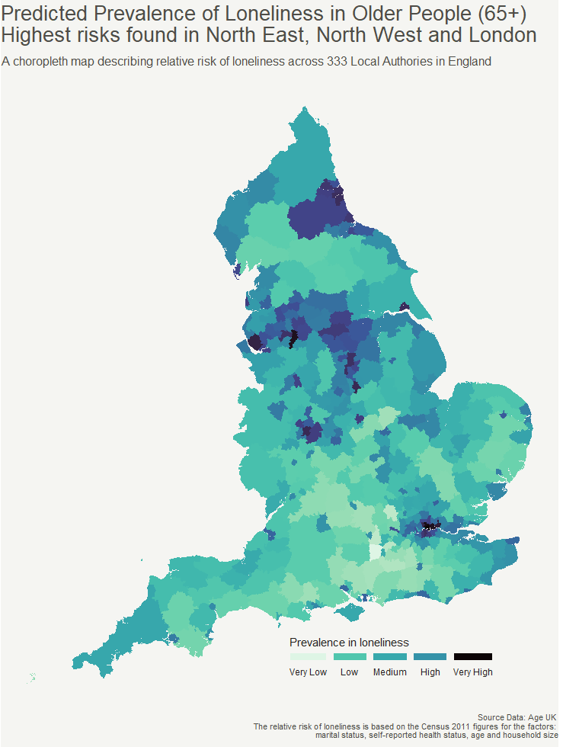
Dataset & Discussion
This dataset contains records of 333 Local Authorities, 9 regions
This map identifies “hotspots” where the prevalence of loneliness is highest by Local Authority
On scale from very low to very high risk, highest is seen in 3 regions across England
Different population size, similar scale of prevalence
Co. Durham in North East, estimated population over 65: 111,582
Manchester in North West, estimated population over 65: 51,557
London, estimated population over 65: 10,98,453
Notes:
Point 1
This is a univariate analysis visualising with a choropleth map showing the distribution of relative risk in loneliness.
READ BULLET
There are across 333 local authorities in England, which grouped into 9 regions
Each tile is a local authority. The size of the tile is representative to the size of the area.
Point 2
The map summarises relative risk into 5 scales from very low, low, medium, high and very high
Lower risk is lighter and diverge to darker scale as the risk increases
READ BULLET
Point 3
READ BULLET
We see that Co. Durham in North East there are est popu over 65: 111,582

Slide 5
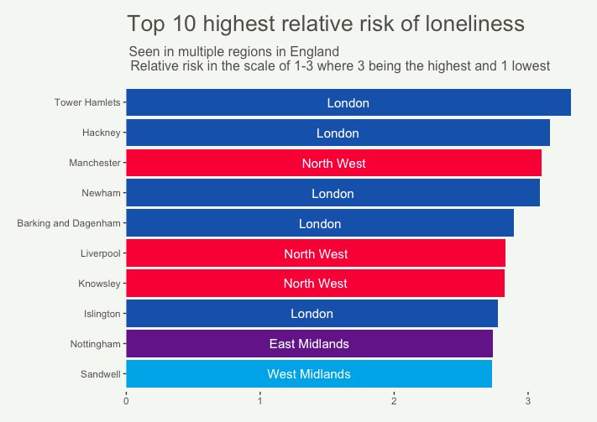
Dataset & Discussion
Similar to the map, London, and North West are in the top 10 area at risk
East Midlands and West Midlands are the additions
X Axis is the unit of Relative Risk in the continuous scale between 0 to 3 where higher number reflects higher risk and vice versa
Tower Hamlets are 3 times the odd of being lonely
Others exceed two times likely to be effected by loneliness
← Less Likely
Relative Risk Scale
More Likely →
Notes:
Point 1
This bar chat shows top 10 local authorities with highest prevalence in loneliness
BULLET
Point 2
Two other regions not spotted in the map due to being smaller local authorities
Nottingham and sandwell from east and west midlands make it to the top 10 higest risk local authority
Point 3
BULLET

Slide 6
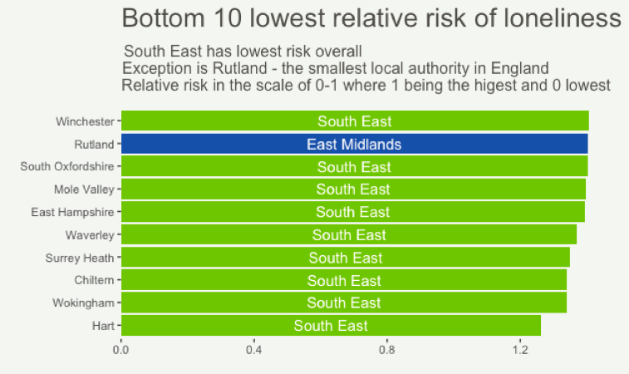
Dataset & Discussion
South East appears to be the best place for the elderly
Rutland is the exception from East Midlands region
Overall, loneliness in elderly is less common in these Local Authorities
← Less Likely
Relative Risk Scale
More Likely →
Notes:
In contrast – the bottom 10 lowest relative risk of loneliness are majority in south east

Slide 7
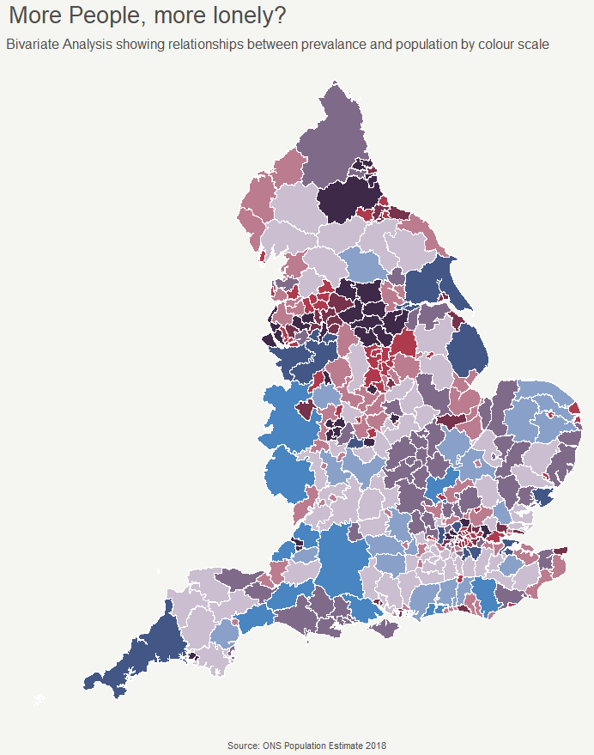

Dataset & Discussion
South West and Yorkshire areas have negative correlation to number of population
In contrast, the positive correlation is present in Co. Durham and Lancashire area
Bivariate analysis gives an additional dimension to the analysis to explore relationships with two variables
High prevalence, higher population
Higher population →
Higher Prevalence→
Higher population, low prevalence
Notes:
Finally, I would like to revisit another version of choropleth map
This is a bivariate analysis which takes another variable mid year estimated population published by the ONS
Populated doesn’t equate to feeling more lonely according to the data. This pattern is more pronounced in the Southern part of England
Meanwhile Co. Durham is concerning with being populated area and also high prevalence of loneliness in elderly too.
BULLET
So previously different scales now we have 9 different way to interpret the data

Slide 8
Justifications
Visualisation memorable “at-a-glance” are capable of effectively conveying the message of the visualisation
2
Notes:
During my literature review, according to Borkin et al research on memory recall and data visualisation
Those that takes longer time to perceive, interpret and comprehend by our brain

Slide 9
Justifications
Technique | Justification
A choropleth map | A choropleth map displays divided geographical areas or regions that are coloured in relation to predicted prevalence value; a numeric variable Usage: Univariate & Bivariate Analysis Colour scheme: Diverge scale of Green / Blue giving 5 different levels where green is less likely to be lonely and blue is higher risk effected by loneliness. Five shades represent different scale of risks.
A bar chart | A bar chart is used to display the relationship between a numeric (relative risk) and a categorical variable (Local Authority) The relative risk only takes positive number and has lower bound of 0 and upper bound of infinity. The chart is limited to 10 categorical variables which is an appropriate number for the estate of this chart. Colour scheme: Each region is assigned with a colour
A choropleth map | Like above, this shows geographical areas with a matrix of scales. Using two variables; loneliness prediction and number of populations, extends to a total of 9 levels of information
Notes:
Here is the table that summarise by the techniques I chose for this data story telling
As the objective is to find hotspots I use Bold colour / mako theme – found in the reference to draw the attention and lighter colour for lower risk so it doesn’t distract the audience

Slide 10
Justifications
Slide | Technique | Justification
Slide 4: Univariate Analysis of predicted prevalence of loneliness by Local Authority | A choropleth map | A choropleth map displays divided geographical areas or regions that are coloured in relation to predicted prevalence value which is a numeric variable Colour scheme: Diverge scale of Green / Blue giving 5 different levels where green is less likely to be lonely and blue is higher risk effected by loneliness. Five shades represent different scale of risks.
Slide 5 & 6: Top 10 / Bottom 10 | A bar chart | A bar chart is used to display the relationship between a numeric (odd ratio) and a categorical variable (Local Authority) The odd ratio only takes positive number and has lower bound of 0 and upper bound of infinity. The chart is limited to 10 categorical variables which is an appropriate number for the estate of this chart. Colour scheme: Each region is assigned with a colour
Slide 7: Bivariate Analysis of relationship between prevalence in loneliness and number of populations by Local Authority | A choropleth map | Like above, this shows geographical areas with a matrix of scales. Using two variables; loneliness prediction and number of populations, extends to a total of 9 levels of information
Notes:
Note 1: as mentioned previously – the focus is to explore the spatial pattern in the neighbourhoo so slide 4 is appropriate

Slide 11
Appendix
The code for this analysis is available here:
Run the following files in this Github repository:
https://raw.githubusercontent.com/nujcharee/DSDA_Data/main/Slide4.R
https://raw.githubusercontent.com/nujcharee/DSDA_Data/main/Slide5_6.R
https://raw.githubusercontent.com/nujcharee/DSDA_Data/main/Slide7.R
Notes:
Here you can find the repository with codes which gives information for anyone who wish to reproduce the visualisations. This is openly accessible by anyone.

Slide 12
References
Rahlf, T., 2017. Data visualisation with R: 100 examples. Springer
Kearns, A., Whitley, E., Tannahill, C. and Ellaway, A., 2015. Loneliness, social relations and health and well-being in deprived communities. Psychology, health & medicine, 20(3), pp.332-344.
Pyle, E. and Evans, D., 2018. Loneliness-what characteristics and circumstances are associated with feeling lonely. Newport: Office for National Statistics.
Rudis, B. and Ross N., 2019. Introduction to the viridis color maps. Available at: https://cran.r-project.org/web/packages/viridis/vignettes/intro-to-viridis.html (Accessed: 18th May 2022)
The following are the source files used in the analysis:
File path | Description
https://raw.githubusercontent.com/nujcharee/DSDA_Data/main/CT0467.csv | The dataset contains a prediction of the prevalence of loneliness amongst usual residents, living in households, aged 65 in England
https://github.com/nujcharee/DSDA_Data/blob/main/Local_Authority_Districts_(December_2011)_Boundaries_EW_BFC.zip | England map base shapefile which contains geometry data and Local authority boundaries
https://raw.githubusercontent.com/nujcharee/DSDA_Data/main/pop.csv | Mid-year Estimated Population over 65 in England (2018)

